Slide 1
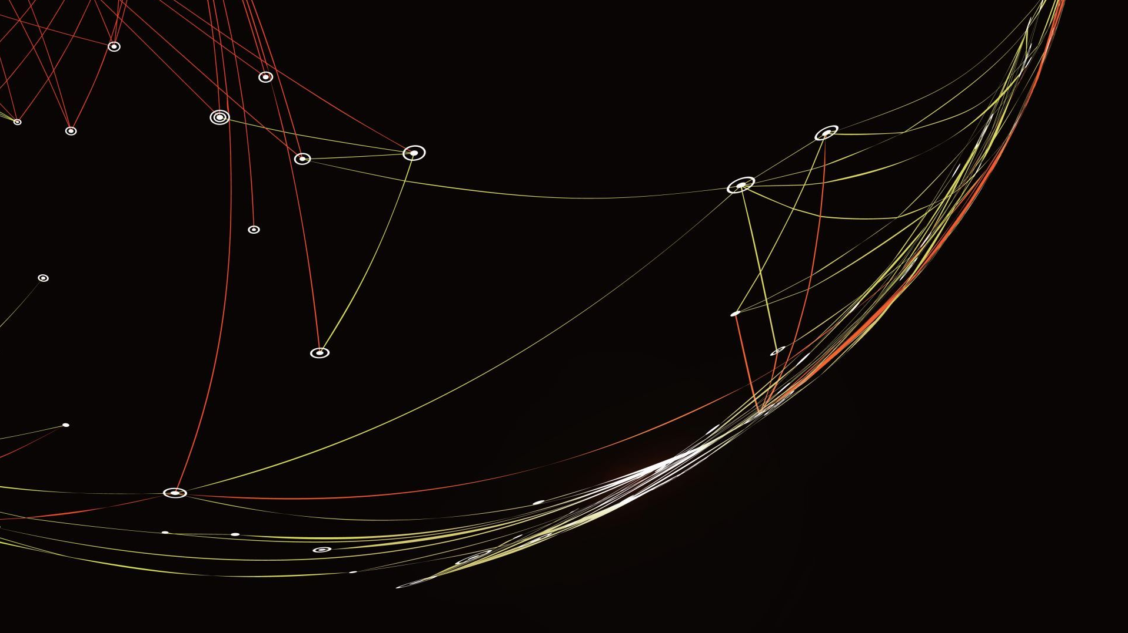
IOT
Internet Of Things

Slide 2
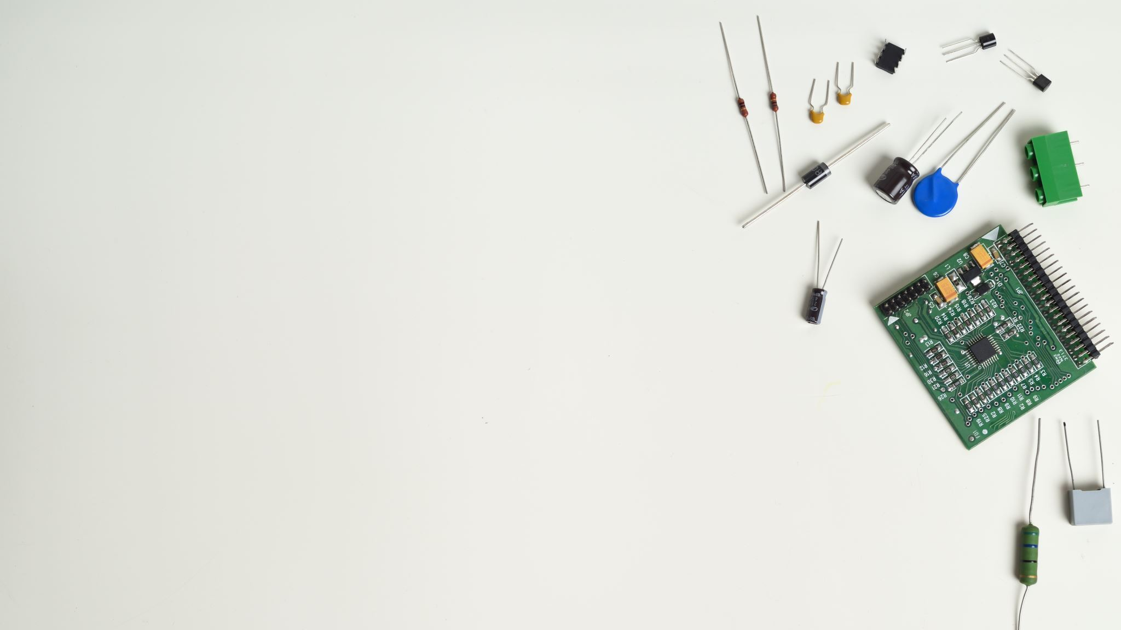
What is iot?
The Internet of Things (IoT) describes the network of physical objects “things” that are embedded with sensors, software, and other technologies for the purpose of connecting and exchanging data with other devices and systems over the internet.
Example: vehicles, plant electronic systems, roofs, lighting, etc.

Slide 3
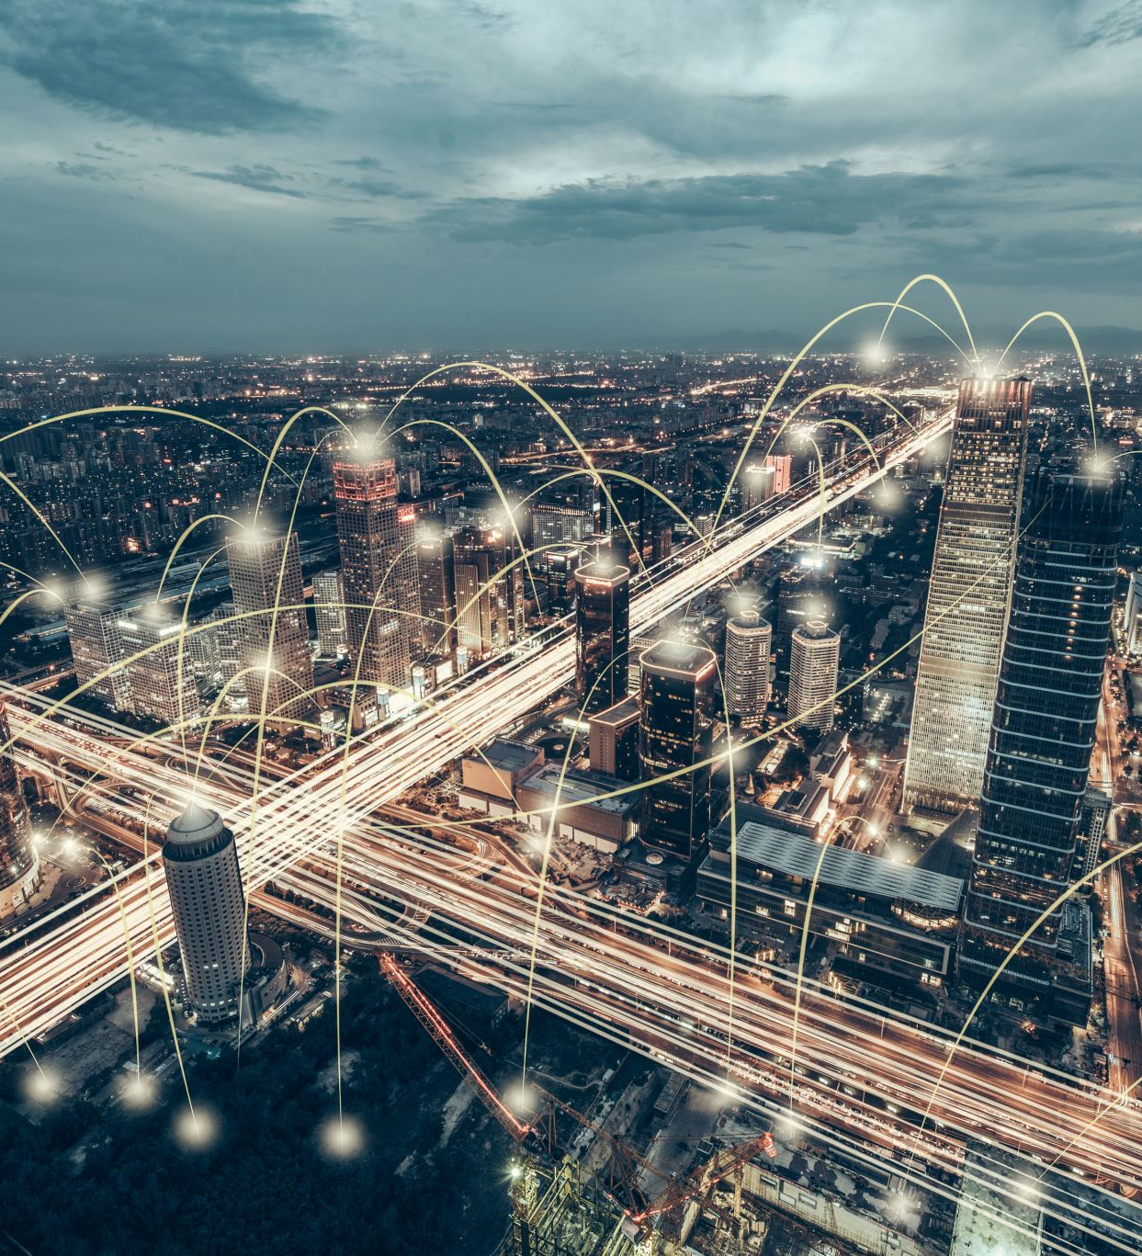
Uses of iot
Over the past few years, IoT has become one of the most important technologies of the 21st century. Now that we can connect everyday objects—kitchen appliances, cars, thermostats, baby monitors—to the internet via embedded devices, seamless communication is possible between people, processes, and things.
Smart Home and Office.
Wearable Devices.
Autonomous Driving.
Agriculture and Smart farming.

Slide 4
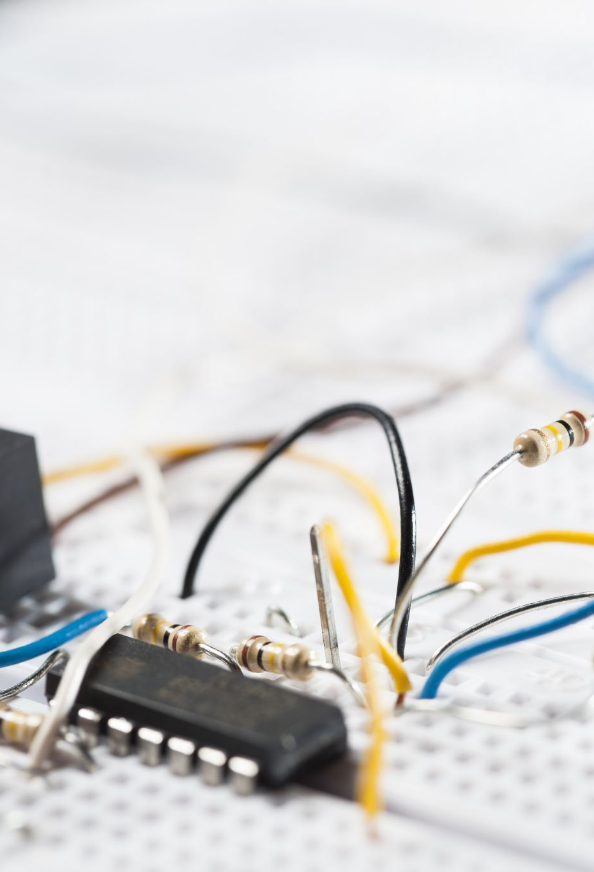
Python packages used for iot
NumPy and Pandas
Matplotlib and Seaborn
Paho-mqtt
Tensor flow
Blynk
Zerynth
Twisted
PyOTA
Pyserial

Slide 5
PACKAGES
NumPy: NumPy is a scientific computing package that provides a fast and efficient way to work with arrays and matrices. This makes it ideal for processing data from IoT devices, which often generate large amounts of data.
Pandas: Pandas is a data analysis package that makes it easy to manipulate and visualize data. This makes it ideal for exploring and understanding data from IoT devices.
Matplotlib: Matplotlib is a plotting library that can be used to create graphs and charts from data. This makes it ideal for visualizing data from IoT devices.
Seaborn: Just like matplotlib Seaborn is also a data visualization library

Slide 6
paho-mqtt: A client library for MQTT (Message Queuing Telemetry Transport) protocol, which is commonly used for lightweight messaging between IoT devices and the cloud.
Tensor flow:Tensorflow is basically all about numerical computations as it’s built on Numpy. It harvests a different mathematical representation called data slow graphs where nodes are for mathematical operations and edges as data arrays.
Blynk: Blynk is a platform for building IoT applications. It provides a Python library that allows you to connect your IoT devices to the Blynk cloud and control them via a mobile app.
Zerynth: Zerynth is a Python-based IoT development platform that offers a range of libraries for various IoT protocols and boards. It provides tools for device provisioning, communication, and over-the-air updates.

Slide 7
Twisted: Twisted is an event-driven networking engine written in Python. It can be used for building IoT applications that require asynchronous networking and handling of multiple connections.
pySerial: A library for serial communication, often used to interface with sensors, actuators, and other devices that communicate over a serial port.
PyOTA: PyOTA is a Python library for interacting with the IOTA (Internet of Things Application) protocol. It allows you to build applications that leverage IOTA's distributed ledger technology for secure and scalable IoT data exchange.

Slide 8
Why python for iot?
Python's ease of use, extensive library ecosystem, cross-platform compatibility, and strong community support make it a popular choice for IoT development. It enables developers to quickly prototype, integrate with different systems, and build powerful IoT applications with data analysis and machine learning capabilities.
• Integration Capabilities
° Support for Hardware Interfaces
• Cross-Platform Compatibility
° Large Developer Community

Slide 9

HIGHWAY ACCIDENT DETECTION MODEL
Free way: Freeway is type of High-way where there are no police, signals, rules ect,. Typically here there are is monitoring. So there are high chances to accidents. Thus is it much essential to install a RTMS senor on either side of the road to track the accidents.
RTMS Sensor: RTMS (Radar Traffic Monitoring System) is a type of sensor used in IoT (Internet of Things) applications for traffic monitoring and management. It utilizes radar technology to detect and monitor the movement of vehicles on roads or highways

Slide 10
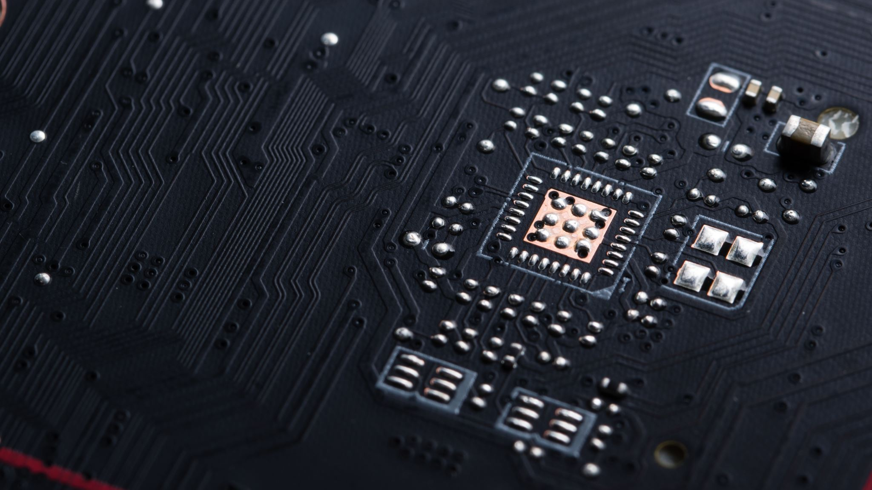
Rtms sensor
RTMS sensor typically consist of many useful components related to real-time data collection especially for vehicles like velocity calculation, acceleration, distance ect,.
RTMS sensor generally do image segmentation on vehicles simultaneously. So that it will be easier to action immediately.

Slide 11

Thank you

